Slide 1
Flutes vs. Cellos: Analyzing Mobility-Traffic Correlations in Large WLAN Traces
This talk was presented at INFOCOM 2018
Babak Alipour*, Leonardo Tonetto, Aaron Yi Ding, Roozbeh Ketabi, Jörg Ott, Ahmed Helmy
Computer and Information Science and Engineering,
University of Florida (UF)
Department of Informatics,
Technical University of Munich (TUM)
Notes:
Babak Alipour (babak.ap@ufl.edu, babak.alipour@gmail.com) is the presenter of these slides at IEEE InfoCom 2018. He is PhD student at University of Florida, supervised by Prof. Ahmed Helmy (helmy@ufl.edu).
Tech report of this publication can be found at https://arxiv.org/abs/1801.02705
* This is the result of 4 years of efforts and collaboration between UF and TUM, with this work as a stepping stone for future integrated mobility-traffic models.
* Big data used here is 30TB in size.

Slide 2
Outline
Introduction: Motivation, Framework
Datasets & Device Classification
Mobility Analysis
Traffic Analysis
Integrated Analysis
Conclusion

Slide 3
Motivation
Two major factors affecting mobile network performance are:
mobility and network traffic patterns and models.
Simulation, analysis, and prediction schemes rely on such models.
Earlier mobility modeling studies use pre-smartphone WLAN traces.
Mobility-Traffic Interdependence not well-studied:
Earlier models designed independently
No integrated mobility-traffic models exist!*
Notes:
Mobility & Traffic Aspect/Dimension/Plane
Several datasets can be found in CRAWDAD [https://crawdad.org/] and MobiLib [https://www.cise.ufl.edu/~helmy/MobiLib.htm]
* There is also a scarcity of publicly available datasets containing both dimensions.
* Mobility, Network usage, and device type characterize different aspects of human behavior.

Slide 4
Goals
(I) How different are mobility and traffic features across:
device types – time – space ?
(II) What are the correlations between these features?
(III) Should new integrated mobility-traffic models be devised to capture the differences?
What is the value/utility of integrating mobility and traffic?
Notes:
Goal I) It’s about finding the trends.
Goal II) It’s necessary to answer goal III.
The main goal of this study is to provide the foundation for an integrated mobility-traffic model.

Slide 5
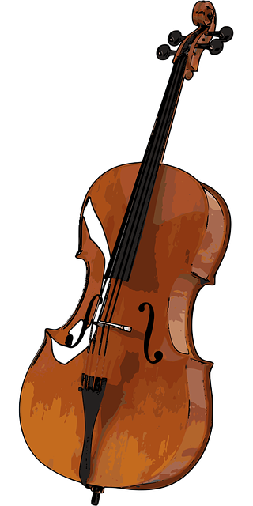
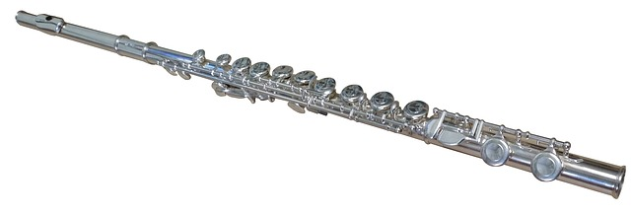
Flute vs Cello Mobility
Flutes
Cellos
Captures ‘on-the-go’ usage scenarios (i.e., smartphones)
Higher mobility expected, needs to be quantified
Traffic patterns?
Captures ‘sit-to-use’ usage scenarios (i.e., laptops)
Lower mobility expected, needs to be quantified
Traffic patterns?
Comparison not well-studied
Goal I) How different are mobility and traffic characteristics across device types, time and space?

Slide 6
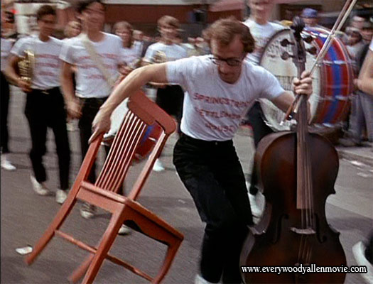
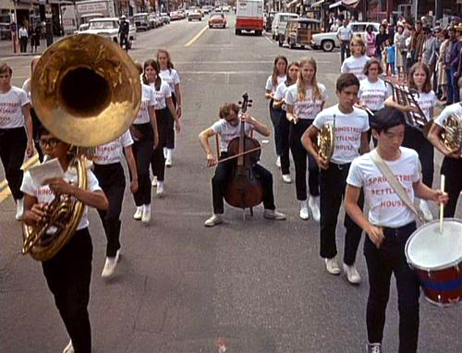
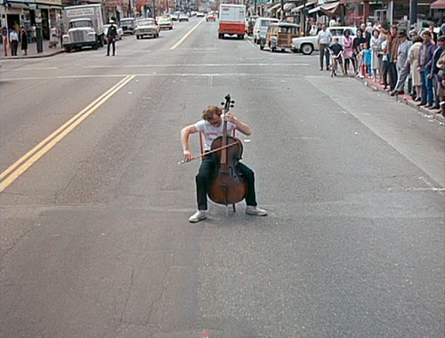
Cello ‘Mobility’*!!
* We thank Prof. Mostafa Ammar for suggesting the term ’cello mobility’

Slide 7
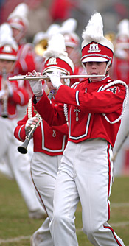
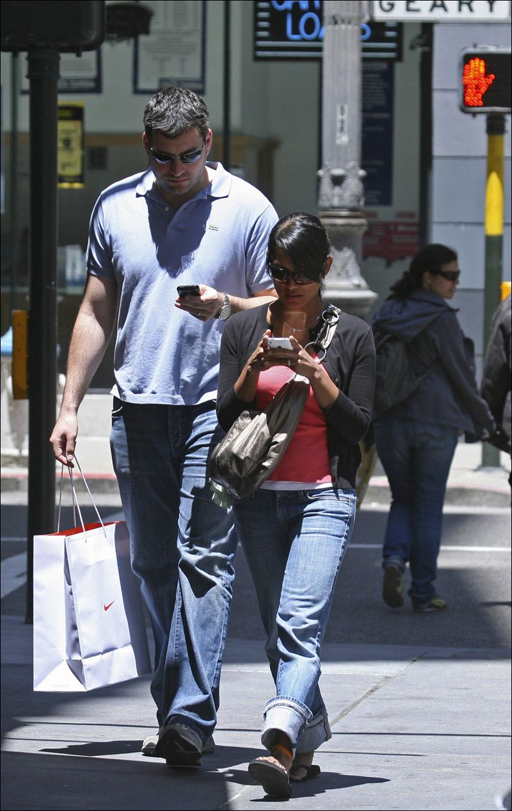
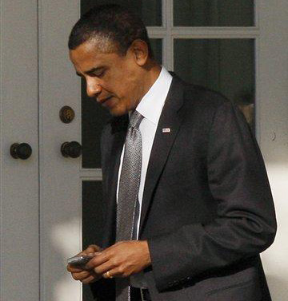
Flutes vs Cellos:
Cellos , Laptops = sit-to-use
Flutes, Smartphones = use-on-the-go

Slide 8
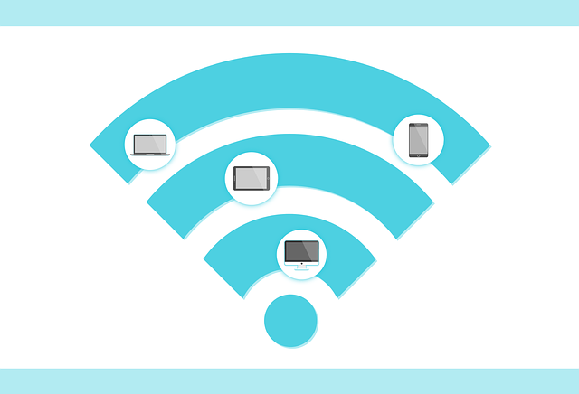
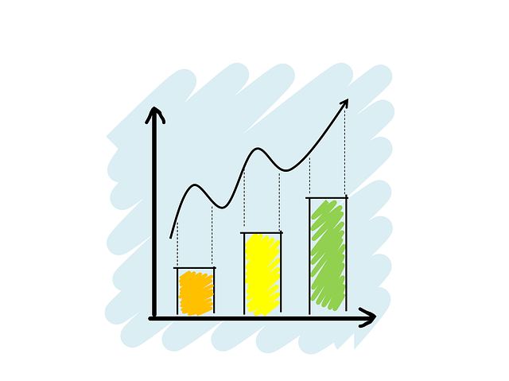
Framework (Abstract)
Data
WLAN Traces
NetFlow
Analysis
Cellos vs Flutes
Spatio-Temporal Characteristics
Modeling
Mobility & Traffic feature extraction
Correlations
Device Classes
DHCP
Core (merged)
Traffic and Mobility Features
Mixture Models and Synthesis
Notes:
Let’s walk through the framework from the data, through analysis and all the way to modeling insights.

Slide 9
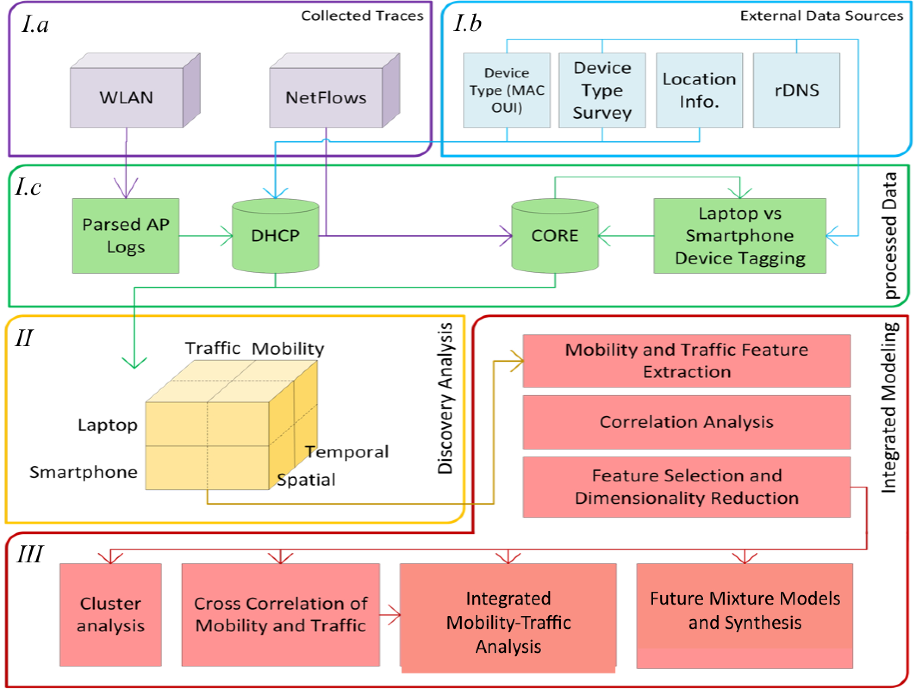
Framework
(detailed)
FLAMeS System Overview
(Framework for Large-scale Analysis of the Mobile
Society)
Notes:
3 Layers, the first layer has 3 parts (a, b, c)

Slide 10
FLAMeS Framework
Framework
Multi-sourced data, Modular design, to address our goals of:
Goal I) Get device type, time and space features
Goal II) Analyze relationships
Goal III) Quantify the value of integrated model

Slide 11
Outline
Introduction
Datasets & Device Classification
WLAN
NetFlow
DHCP and Core
Auxiliary Datasets
Mobility Analysis
...

Slide 12
FLAMeS Framework
Datasets
Goal I) Get device type, time and space features

Slide 13
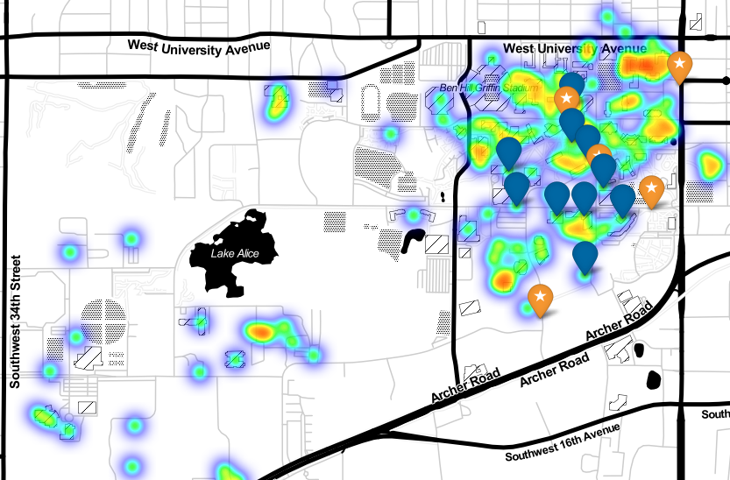
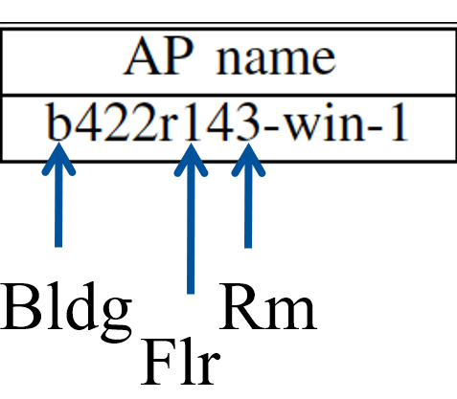
Datasets (WLAN, NetFlow, Aux.)
WLAN
555M records (association/authentication events)
Includes: user MAC, AP MAC & Name, IP address, timestamp.
1760 access points in 138 buildings over 479 days (2011-2012).
316k devices.
AP name embeds location information.
Building, floor and room numbers.
Google Maps API used to fetch latitude/longitude*.
Building Room
Floor
Notes:
Datasets comes from APs located on University of Florida campus.
* We fetched 8000 mapped APs around the campus area from a crowd-sourced service, wigle.net.
For the 130 matched APs in 42% of buildings (i.e., 58 bldgs), all were less than 200m from their mapped location; an error of less than 1.5% of the campus area. This is very reasonable for our study purposes.

Slide 14
Datasets (WLAN, NetFlow, Aux.)
NetFlow
76 Billion records (30TB in size*), 80k devices.
Includes source/destination IP addresses and port numbers, protocol, packet count, size, and duration.
Same wireless network (University of Florida campus), April 2012.
NetFlow sample data
Notes:
* In plain text, raw, uncompressed format. Very compressible.

Slide 15
Datasets (WLAN, NetFlow, Aux.)
Reverse DNS (*)
Device type survey
University buildings listing
Google Maps API
Crowd-sourced wigle.net data
Used for device type classification
Used for location verification
Notes:
* https://scans.io/study/sonar.rdns, MIT-license

Slide 16
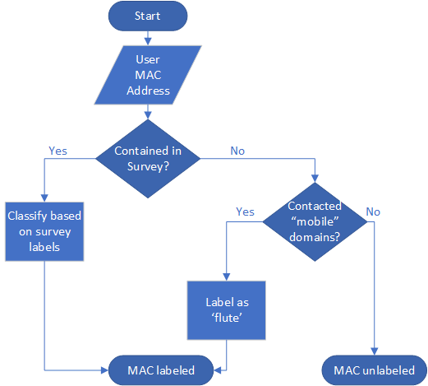
Device-type Classification Flowchart
Overall: 97% of devices in NetFlow labeled (~50k flutes, ~27k cellos) *
00:D0:B7 # Intel Corporation
00:D0:B7:01:02:03 User MAC
Cello**
Notes:
Using a survey of MAC prefixes, we find the manufacturer. Otherwise, we use ‘mobile’ domains, which are the domains typically used when a browser with a mobile device agent is detected.
* Out of ~80K devices in NetFlow/Core dataset.
** We are not aware of any Intel-branded flutes during the collection duration of the WLAN dataset.

Slide 17
Time series for 25 days of combined WLAN-NetFlow traces after preprocessing and sanitation of datasets
Notes:
We’re done with preprocessing and sanitation of datasets.

Slide 18
Goals
(I) How different are mobility and traffic features across:
device types – time – space ?
(II) What are the correlations between these features?
(III) Should new integrated mobility-traffic models be devised to capture the differences?
What is the value/utility of integrating mobility and traffic?
But what are the characteristics of mobility and traffic dimensions?

Slide 19
FLAMeS Framework
Goal II) Analyze relationships/correlations of this data cube
Data cube, traffic/mobility analyzed temporally, spatially, and per device type
Notes:
We’re done with preprocessing and sanitation of datasets, let’s move on to analysis of this data cube.

Slide 20
Outline
Introduction
Datasets & Device Classification
Mobility Analysis
Features
Results
Traffic Analysis
...

Slide 21
Mobility
Choose mobility features that capture human movement patterns:
Session start probability
Radius of gyration
Visitation preferences and interests
Session duration per building
Hourly associations
Return probability …
Analyze these features independently, before integration with traffic.
Notes:
The selected list of features was chosen to capture human mobility patterns, based on exploratory analysis and prior literature.
Several other features that were highly correlated (>0.9 Pearson’s r) were removed.

Slide 22
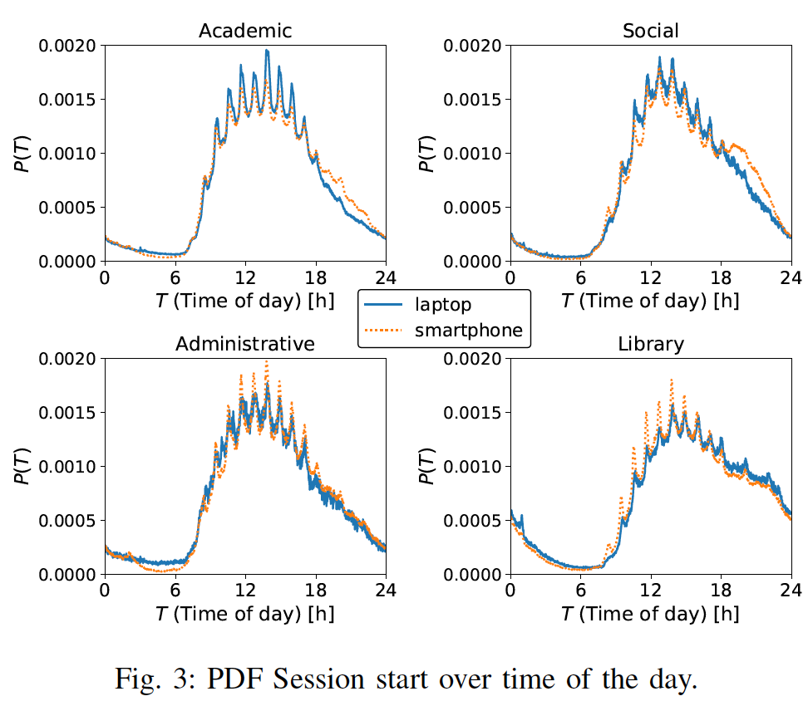
Session start probability
Break
Spikes match periodic classes (strongest: Cellos in academic bldgs.)
Significant drop after 5pm for Cellos in academic and social.
Reversal of prob. after 5pm in academic, social and library.
Class
Notes:
Please note that the most significant spikes are in academic buildings, where most of the devices starting sessions during class hours are Cellos.

Slide 23
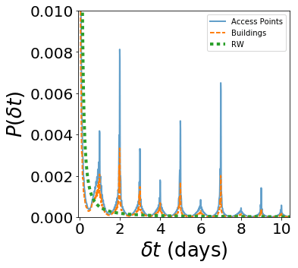
MWF
Tue,Th
1 week
Return probability
Returning spikes at every 24 hours, with the highest peaks at 48 and 168 hours (2 and 7 days, corresponds to schedule of classes, Tuesday/Thursday or Monday/Wednesday/Friday)
No significant difference between flutes and cellos.
Notes:
RW: Random Walk
This metric captures intra-semester periods. Surprisingly, the highest spike is at 2 days.
This is in contrast to some other related studies that found the highest spike on 24 hours.
Class schedules are usually Tuesdays/Thursdays (2 days apart) or Monday/Wednesday/Friday (again 2 days apart).
Flutes and cellos show similar behavior in terms of return probability

Slide 24
Mobility Analysis Summary
Quantified features: jumps, radius of gyration, number of APs visited,…
Flutes:
have higher overall mobility – likely in social and housing bldg.
Cellos
visit fewer places – likely in academic bldg. – some active in weekends.
Different behaviors on weekdays vs. weekends.
Similar pattern of return probability (peaks at 2 & 7 days).

Slide 25
Weekday
Weekend
LJM: maximum jump [m]
DIA: diameter [m]
TJM: total trajectory length [m]
Summary of
Mobility Features
GYR: radius of gyration [m]
BLD: no. uniq. buildings
Up to 3 orders of magnitude difference between Cellos and Flutes
APC: no. uniq. APs
PDT: time spent at preferred building [min]
DLT: total session time at each building [s].

Slide 26
Outline
Introduction
Datasets & Device Classification
Mobility Analysis
Traffic Analysis
Integrated Mobility-Traffic analysis
Conclusion

Slide 27
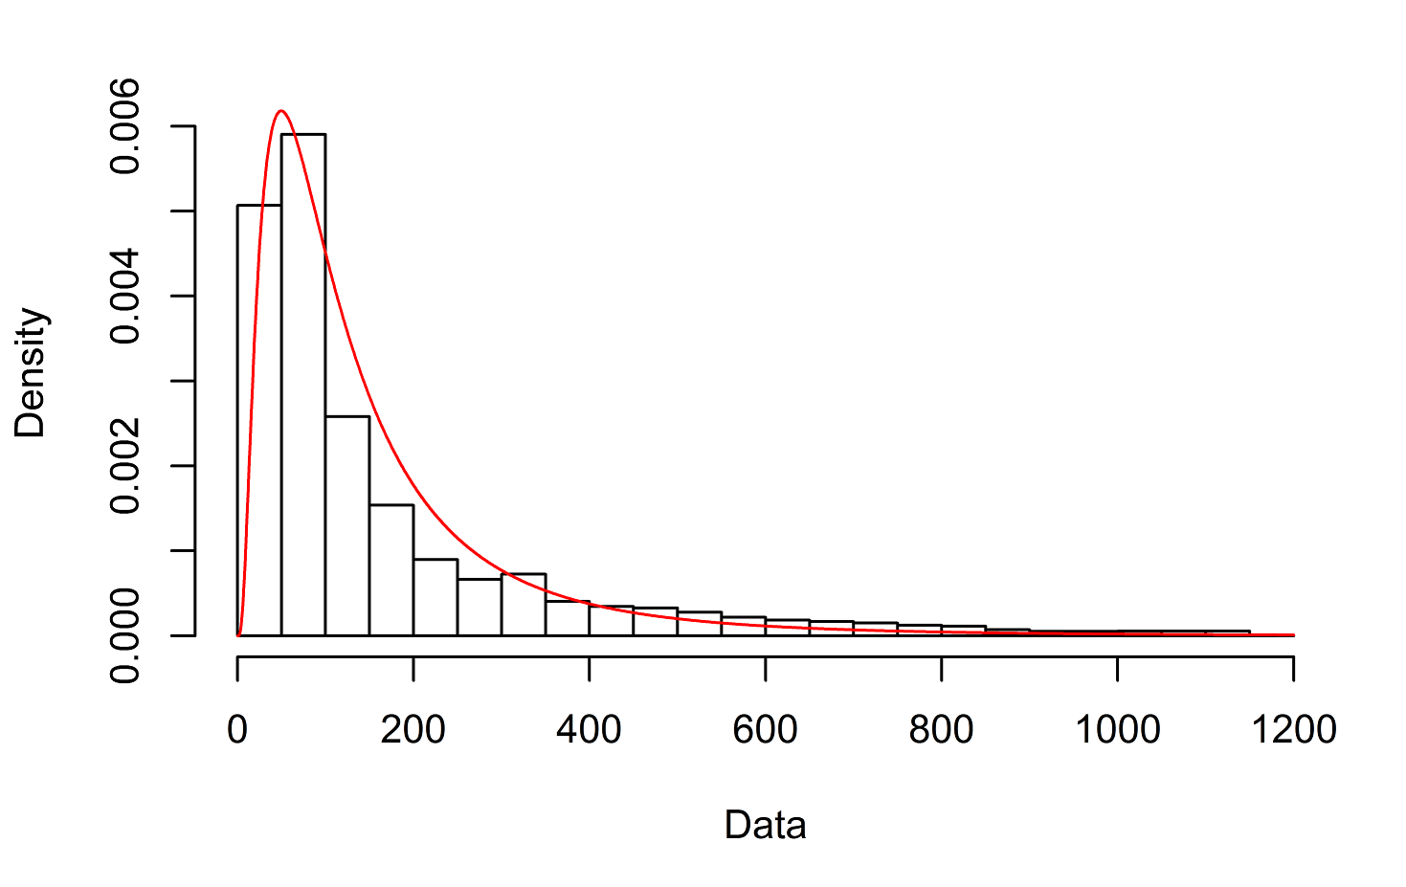
Flow-level statistical characterization
Flute flows are 2x larger on average (more packets and larger packets).
Flow sizes follow a lognormal distribution*:
Lognormal fit
Flow sizes
Notes:
* Lognormal fit for flow sizes has been shown in the research before [1], and was verified on our dataset.
[1] “On the log-normal distribution of network traffic”, Antoniou, I and Ivanov, Victor V and Ivanov, Valery V and Zrelov, PV 2002
* Lognormal fits for the two device types have very different parameters.

Slide 28
Network-centric (spatial) analysis
Cellos consume more traffic!
Much higher traffic consumption on weekdays!
Although flute flows are bigger, there are fewer of them → Overall, flutes consume less data.
Weekends
Weekdays
MB per day, log-scale

Slide 29
User-centric (temporal) analysis
Flutes
(smartphones)
Cellos
(laptops)
Cellos have 4x average active time compared to flutes.
Active time of cellos increases on weekends. (fewer devices, but more active)
Flutes are more bursty.
Active time (minutes per day)
Notes:
Joke: Graduate students on weekends with their cellos!?

Slide 30
Traffic Analysis Summary
Flutes:
More bursty, with bigger flows and lower active duration
Potential causes: Intermittent usage, bundling of requests to save battery.
Cellos consume more (higher overall traffic volume, packet rate, etc.)
Different behaviors on weekday and weekends.
Separation of device types & weekday/weekend across both Mobility and Traffic planes is important for planning, modeling and simulation.

Slide 31
Weekday
Total flow bytes
Weekend
Avg. flow bytes
Std. flow bytes
Total active time
Summary of
Network Traffic Features
Avg. active time
Total flow count
Std. flow counts
Up to 2 orders of magnitude difference between Cellos and Flutes
UDP bytes / total bytes
UDP flows / total flows
Avg. IAT
Std. IAT

Slide 32
Outline
Introduction
Datasets & Device Classification
Mobility Analysis
Traffic Analysis
Integrated Mobility-Traffic Analysis
Conclusion

Slide 33
Goals
(I) How different are mobility and traffic features across:
device types – time – space ?
(II) What are the correlations between these features?
(III) Should new integrated mobility-traffic models be devised to capture the differences?
What is the value/utility of integrating mobility and traffic?
Notes:
Goal I) It’s about finding the trends.
Goal II) It’s necessary to answer goal III.
The main goal of this study is to provide the foundation for an integrated mobility-traffic model.

Slide 34
FLAMeS Framework
Goal III) Should new models be devised? What is the value and utility of an integrated model?

Slide 35
INTEGRATED MOBILITY-TRAFFIC ANALYSIS
Why?
Mobility, Network usage, and device type characterize different aspects of human behavior.
They are usually studied independently, but they are correlated.
Need to quantify and model relationships among these features.
How?
Feature engineering
Statistical distribution fitting and machine learning

Slide 36
INTEGRATED MOBILITY-TRAFFIC ANALYSIS
Feature engineering
Mobility
Traffic
Cross-dimension
Modeling insights

Slide 37
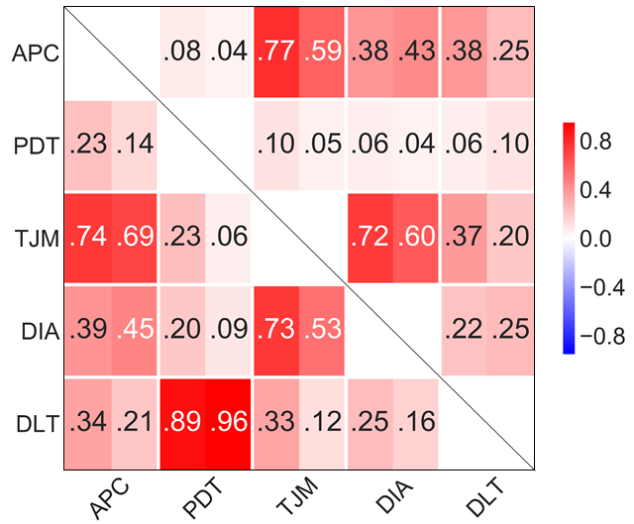
Feature engineering : Mobility
Weekday
Flute
Cello
Weekday
Correlation-based feature selection (CFS)
Selected features are:
DLT: Delta time between network associations
DIA: Diameter of mobility
TJM: Total (sum) jumps
PDT: Delta time at preferred bldg.
APC: Unique AP count
Weekend
Weekend
Correlation plot of mobility features*
Notes:
* The top triangle corresponds to weekdays, and the bottom is for weekends. Each cell’s right half is for Cellos, and left half is for Flutes.
* Features which were >0.9 correlated with the any of the presented features were removed.
* These features are calculated for each user, over a week.
* The correlation plot for mobility had an error (reversed Y-axis) that has since been fixed in the slides and arXiv tech report.
* For example, the correlation between DLT and PDT is high on weekends and low on weekdays. This is because users do not have many short duration associations on weekends and spend most of their time at their preferred bldgs.

Slide 38
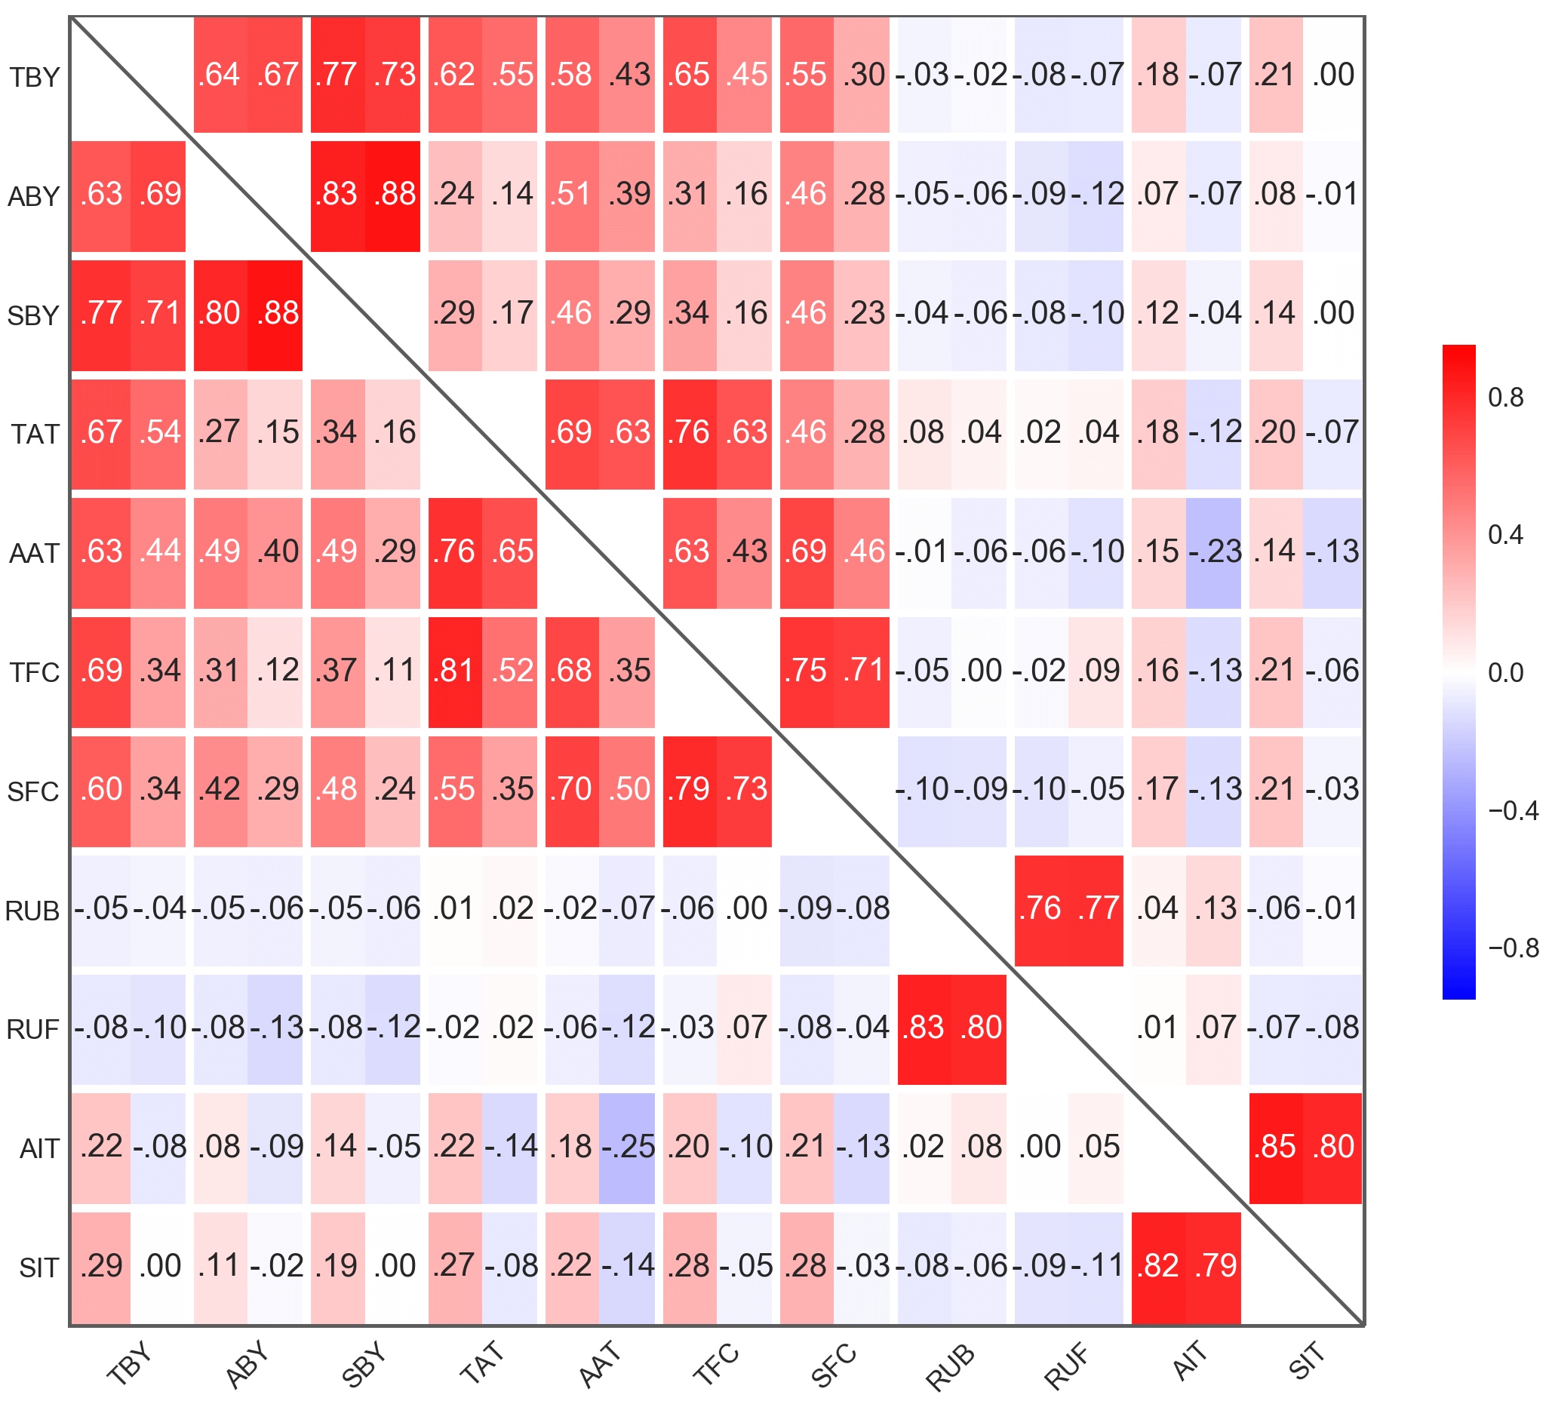
Feature engineering : Traffic
Flute
Cello
Weekday
Selected features are:
TBY: Total flow bytes
ABY: Avg. flow bytes
SBY: Std. flow bytes
TAT: Total active time
AAT: Avg. active time
TFC: Total flow count
SFC: Std. flow count
RUB: ratio of UDP bytes to total
RUF: ratio of UDP flows to total
AIT: Avg. IAT
SIT: Std. IAT
On weekends, Lower for Cellos, Higher for Flutes
Higher on weekends
Weekend
Correlation plot of features*
Notes:
Each cell’s left half is for flutes and right half is for cellos, the upper right triangle is for weekdays and the lower left for weekends.
Features which were >0.9 correlated with the any of the presented features were removed.

Slide 39
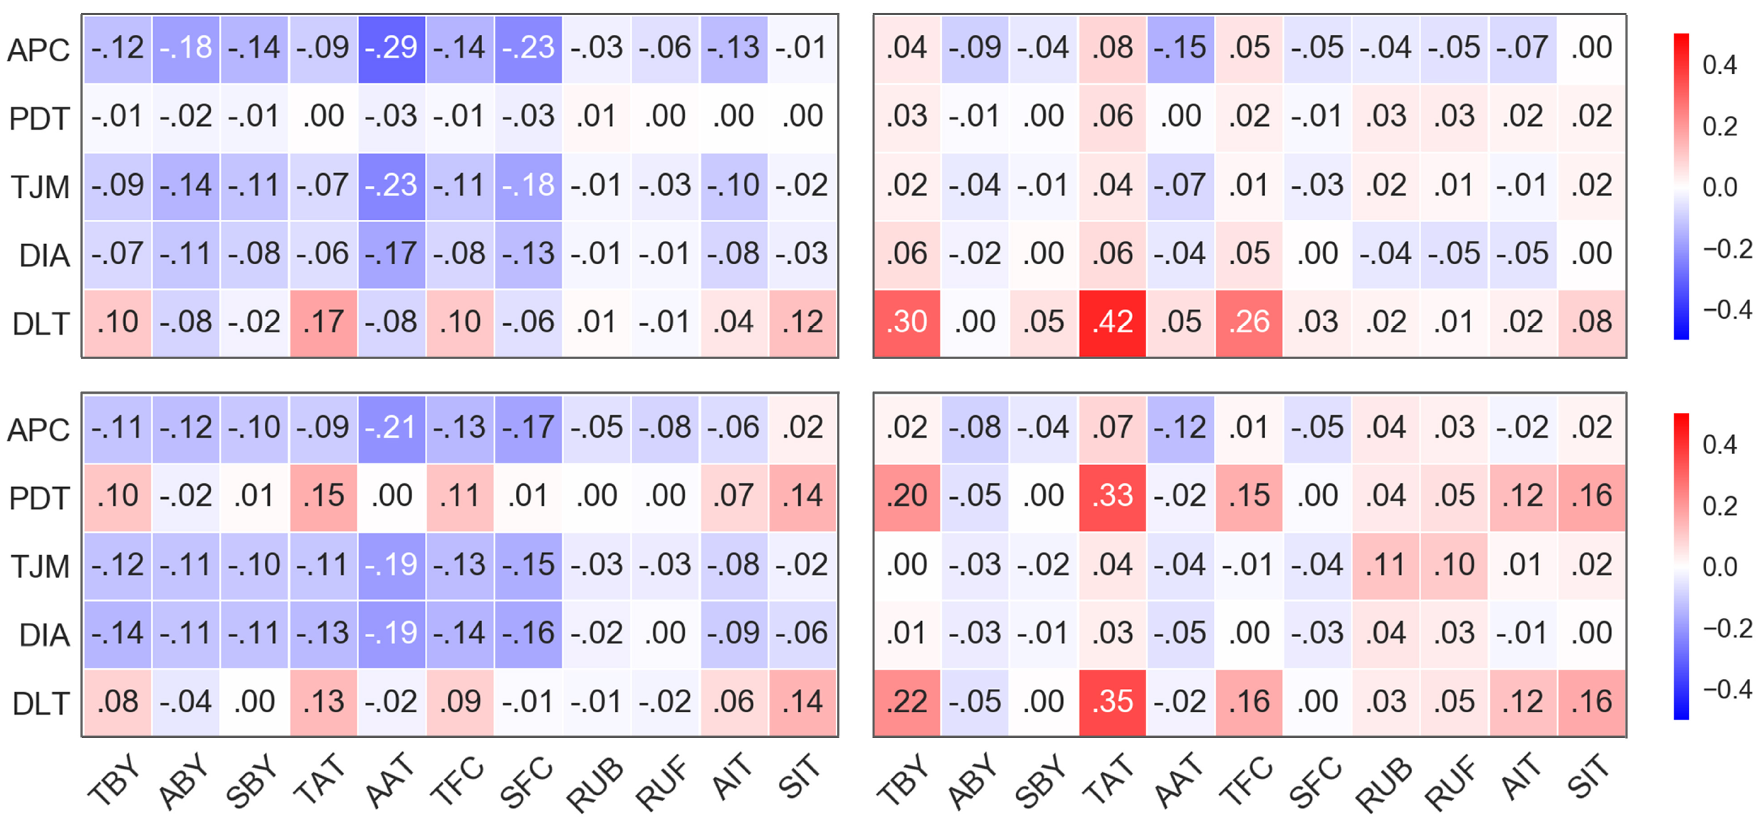
Feature engineering : Cross-dimension
Flute - Weekday
Cello - Weekday
Mobility
Traffic
Flute - Weekend
Cello - Weekend
Correlation of mobility vs. traffic on weekdays (top) vs. weekends (bottom) for flutes (left) and cellos (right).
Notes:
Mobility vs Traffic features for (Flutes/Cellos, Weekday/Weekend)
There are currently no existing models that capture these correlations, that can be crucial in many applications including prediction, caching, resource allocation, among others. They are modeled independently, but correlations matter, and they help in modeling.
​There are more details and explanation in the paper.

Slide 40
INTEGRATED MOBILITY-TRAFFIC ANALYSIS
Feature engineering
Mobility
Traffic
Cross-dimension
Modeling insights
Goal III) What is the value and utility of an integrated model?
Generative modeling

Slide 41
Modeling Insights
Goal III) What is the value / utility of an integrated model?
Capture mobility and traffic features, while maintaining relationships among them.
Allow modeling of device types, such as flutes, cellos, and a spectrum of devices.
Improve accuracy of existing algorithms and applications by revealing cross-dimension features.
Provide a modular, systematic architecture that is extensible and customizable.
Notes:
* Skip if short on time.

Slide 42
Modeling Insights
Goal III) What is the utility of an integrated model?
Can we classify devices using their mobility and/or traffic features?
32% increase in accuracy!
Combined, weekday/weekend separated
Mobility alone
Traffic alone
Combined
Notes:
SVM classifier. 5-fold Cross-Validation. Using default parameters.

Slide 43
Modeling insights
Generative modeling
Various uses in simulation, benchmarking, planning and more.
Based on spatio-temporal features in mobility, traffic, device type
Capture interdependence of features
Privacy preserving*
Gaussian Mixture Model (GMM)
Mobility features
Traffic features
Combined Mobility-Traffic features
Notes:
* This is an important future direction for synthesizing data points.

Slide 44
Modeling insights
Gaussian Mixture Model (GMM)
Using Kolmogorov–Smirnov (KS) test to compare synthetic vs original
 | Test on Mobility |  | Test on Traffic
Train on Mobility | 0.117 | 0.194 | N/A | N/A
Train on Traffic | N/A | N/A | 0.179 | 0.139
Train on Combined | 0.088 | 0.170 | 0.176 | 0.139
25% reduction in error for Mobility!
* Average KS statistic (lower is better).
* Weekday only.
Flute
Cello
Notes:
Similar patterns on weekends were observed (not presented here for brevity).
The parameters of the GMM are the same for the entire table.
​The improvement is likely to increase by using different generative models, which is a work in progress.

Slide 45
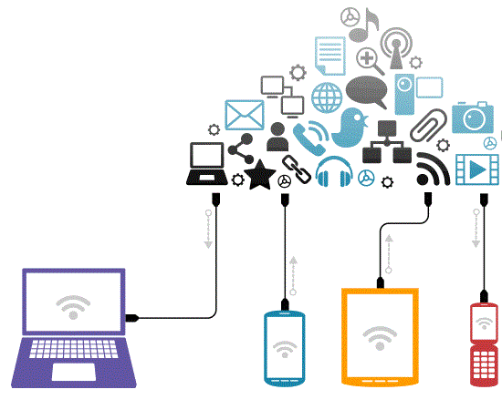
Next steps?
Studying datasets from other network settings and environments to further validate the observed behaviors
Examining the minimum number of parameters required (parsimonious model) to approximate user behavior within given error bounds
Investigation of services and relationship of user interests with spatio-temporal characteristics of mobility and traffic.
Expand device type classification, for example, smartphones vs tablets – do we have “guitars” as well?!
Notes:
* Skip if short on time.

Slide 46
FLAMeS Framework
Framework
Future Framework
Goal I) Get device type, time and space features
Goal I$′$) Get datasets from various environments
Goal II) Analyze relationships
Goal II$′$) Analyze minimum number of parameters for a parsimonious model, expand the cube if necessary
Goal III) Quantify the value of integrated model
Goal III$′$) Investigate services, measure and validate accuracy of generative models
Notes:
Animated slide.

Slide 47
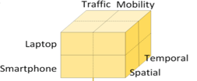
Takeaways
It is crucial to differentiate flutes vs. cellos
for both mobility and traffic.
Correlations of these features matter, and should be captured in models!
There is significant potential for integrated mobility-traffic models that capture relationships across device types, time and space.

Slide 48
Thanks! Questions?
Flutes vs. Cellos: Analyzing Mobility-Traffic Correlations in Large WLAN Traces
Parts of materials will be shared for reproducibility!
Link: cise.ufl.edu/~helmy/MobiLib.htm
Look for Flutes vs. Cellos!
Do you have mobility/traffic datasets? Please let us know ☺
Babak Alipour babak.ap@ufl.edu, Ahmed Helmy helmy@ufl.edu
Notes:
Work in progress!
Do you have mobility/traffic datasets? Please let us know ☺
Tech report of this publication can be found at https://arxiv.org/abs/1801.02705

Slide 49
Acknowledgements:
We thank Dr. Alin Dobra for help in the computing cluster, and the anonymous reviewers for useful feedback.
Dr. Mostafa Ammar suggested the term ’cello mobility’.
Partial funding was provided by NSF 1320694 at Univ. of Florida, August-Wilhelm Sheer fellowship at Technical University-Munich, and Aalto Univ.
Several pictures in the slides from retrieved from https://pixabay.com

Slide 50
Backup Slides

Slide 51
Challenges
Scarcity of publicly available datasets containing both dimensions
Limitations of available datasets and scenarios in time & space
Multi-dimensional comparative analysis
Identifying mobility/network traffic features
Device type categorization
This is the result of 4 years of efforts, with this work as a stepping stone for future integrated mobility-traffic models.

Slide 52
Challenges
Privacy concerns are another important challenge.
An integrated mobility-traffic model should be able to provide synthesized data points that capture the statistical characteristics of data for various applications, without exposing the original data points, and subsequently the users’ privacy.
One of the purposes of our model to have the ability to create ‘virtual campuses’, with adjustable features while also maintaining the relationships among features.

Slide 53
Datasets
DHCP
DHCP logs derived from WLAN events.
A DHCP lease record would indicate: user $α$, AP $β$, IP $γ$, t1, t2
i.e. User $α$, was at AP $β$, associated with IP $γ$ from t1 to t2.
DHCP record 1
Duration = t2-t1
Wireless association logs for a device at different times

Slide 54
Datasets
Core
Merge DHCP and NetFlow to capture mobility AND traffic.
Enables analysis of flows in different locations (spatial analysis)
For a DHCP lease session LS, all flows whose source or destination IP address is the same as the lease, and whose entire lifetime falls within the lease duration, are associated with LS to produce the Core dataset of this study.
i.e. match on src IP / dst IP, and timestamps.

Slide 55
Datasets
NetFlow (top) and AP logs/DHCP (bottom) sample data
Contained in?
Match any?
Unique user ID
Bldg
Rm
Flr
➔ Resulting core dataset contains mobility and traffic information!
Notes:
Due to the massive size of the NetFlow, this join query takes several days .

Slide 56
Device type classification
Two heuristics:
Device type survey*
MAC prefixes (OUI), some manufacturers only produce flutes or cellos.
Labels 46% of devices
NetFlow + Reverse DNS
Find websites mostly serving labeled flutes (e.g. admob.com)
Verify with survey above (92% accuracy**)
Extend classification using OUI of devices contacting such websites
Overall: 97% of devices in NetFlow labeled (~50k flutes, ~27k cellos) ***
Notes:
* We utilized a survey done by our lab under supervision of Prof. Ahmed Helmy.
** Looking solely at the intersection of devices already classified using the survey and admob.com users, 92% are flutes.
*** Out of ~80K devices in NetFlow/Core dataset.

Slide 57
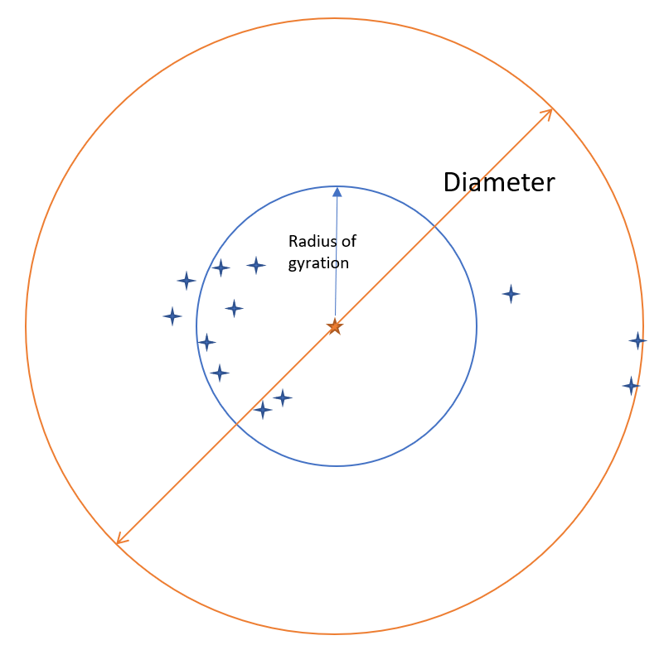
Radius of Gyration (GYR)
Standard deviation of user’s movements and its center of mass (centroid of all movements)
$r_{g}=\sqrt{\frac{1}{n}\sum_{i=1}^{n}{{\left(r_{i}{−r_{cm}}_{}^{}\right)}^{2}}}$
Illustration of Radius of gyration and diameter mobility features
Notes:
Where $r_{i}−r_{cm}$is the distance between a user’s logged location and center of mass.

Slide 58
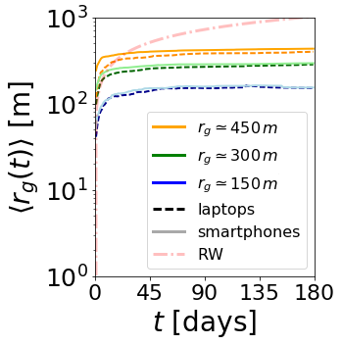
Radius of gyration
After an initial transient period of about one week, this value stabilizes even across different semesters.
For a random walk, radius of gyration keeps increasing.

Slide 59
Radius of Gyration (GYR)
Cellos
Stable after initial transient period of ~1 week, even across semesters (not shown)
Substantial drop for cellos on weekends.
Some flutes show higher radius on weekends.
Despite large campus (8.1km²), area of activity is limited. (more pronounced for Cellos)
Flutes

Slide 60
Visitation preferences and interests
Required time t to visit S(t) locations.
After an initial exploration period of one week the rates of new visits change similarly for both device types, and new exploration rates show up at 120 and 240 days (~120 days is the usual length of a semester).
Fig. 4 (b) Visited locations S(t).
Vertical lines at 7, 120 and 240 days.
Notes:
This metric captures inter-semester behavior.

Slide 61
Visitation preferences and interests
The probability of finding a device at its L-th most visited location.
Similar patterns, but different coefficients for flutes vs cellos
Zipf’s plot on L visited access points for L = 20,25,30,35.

Slide 62
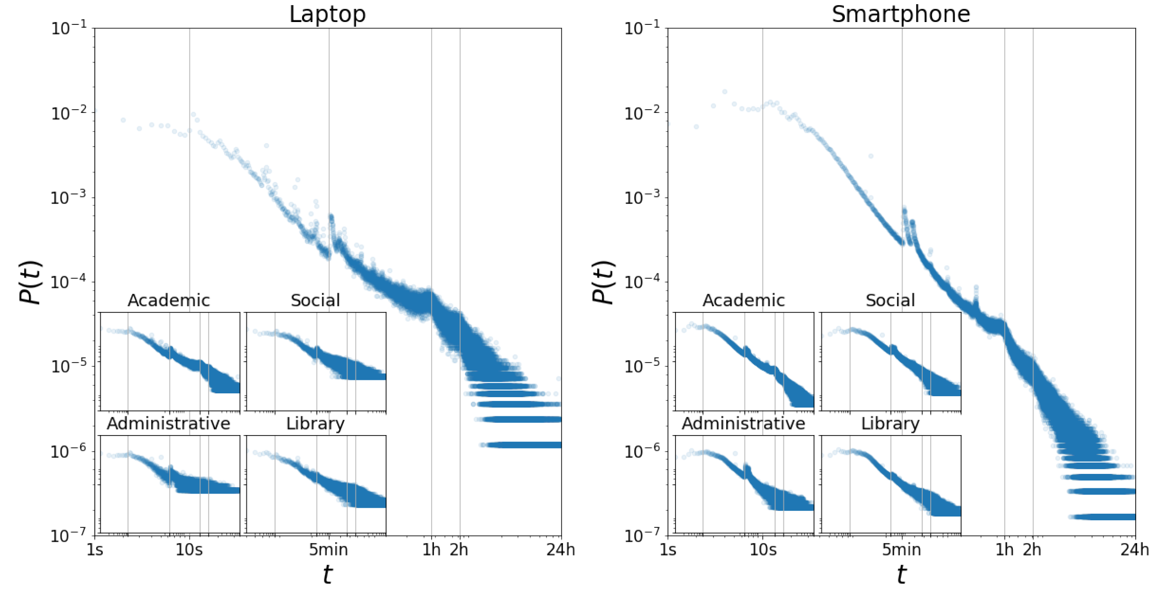
Session duration per building
Knees at 1 and 2 hours at academic bldgs. (correspond to classes) .
Flutes and cellos present certain similarities in their usage, such as during classes
Different building categories show differences. (e.g. Higher probability of long sessions in libraries)
Probability P (t) of session duration t. The scale of all axes in smaller inner plots are the same as their parent plot.

Slide 63
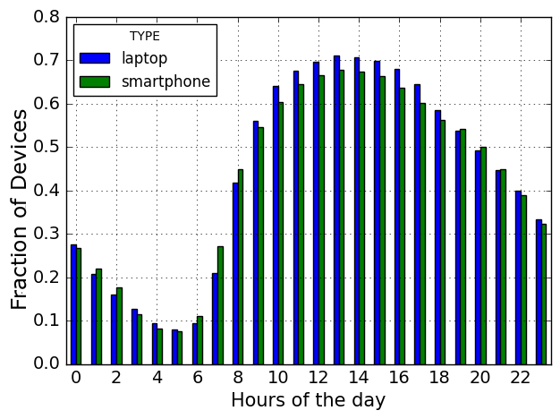
Hourly associations
The majority of devices appear online between 9am and 8pm.
More Flutes likely early morning.
More Cellos likely midday.
More Flutes likely late evening.

Slide 64
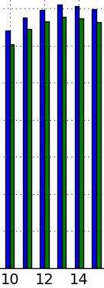
Hourly associations
The majority of devices appear online between 9am and 8pm.
More Flutes likely early morning.
More Cellos likely midday.
More Flutes likely late evening.
Notes:
2 reversals of the device percentages to associate with WLAN happen at 9 AM and 7 PM.

Slide 65
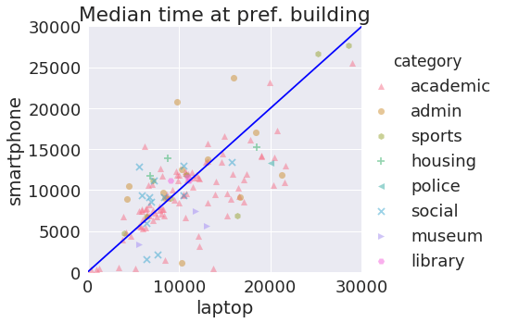
Visitation preferences and interests
academic, police and museum buildings tend to have laptops staying longer.
social and housing buildings, there is a higher probability of having flutes staying longer.
Notes:
* Each dot represents median time for a given location.

Slide 66
Weekday
Weekend
Mobility Features

Slide 67
Traffic
Flow-level statistics
Analyze features of individual users
Important for verification of synthetic data points*
Network-centric (spatial) analysis
Analyze load characteristics from the network viewpoint
User-centric (temporal) analysis
Analyze user behavior over time
Notes:
* An integrated mobility-traffic model should encapsulate statistical characteristics of each dimension (mobility/traffic).

Slide 68
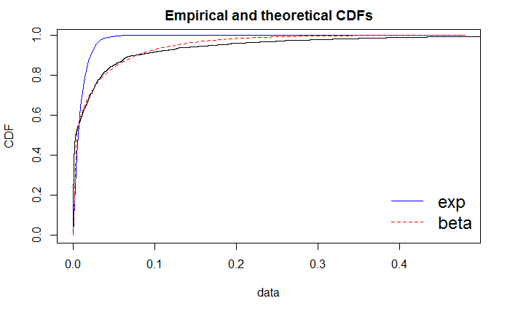
Flow-level statistical characterization
Flow Inter-arrival time (IAT) is 1.8x higher for flutes.
Flow IAT follows a beta distribution
High estimated kurtosis and skewness hints at infrequent extreme values. Flutes face more extreme periods of inactivity overall.
Notes:
* Beta fits for the two device types have different parameters.

Slide 69
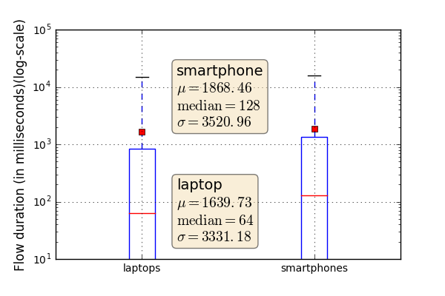
Flow-level statistical characterization
Most flows are short-lived
Average <2s
Median 64ms for Cellos
Median 128ms for Flutes
Prevalence of TCP is much higher in flutes (98.2% vs 78.5% of flows).

Slide 70
Network-centric (spatial) analysis
Why?
Gain insight from viewpoint of the network
Analyze load at different APs for planning
Compare and contrast buildings
How?
Calculate flow metrics for each AP and aggregates per building over weekdays & weekends
Notes:
I will only provide a sneak peak of the spatial (and later temporal) analysis.

Slide 71
Network-centric (spatial) analysis
On weekends:
60% of APs see no flute flows and 70% receive no cello flows.
At least one AP in >80% of buildings sees traffic*.
Traffic is clustered in a few areas (APs) of of each building.
Average traffic consumption and packet rate are half of weekdays.
Median traffic consumption drops to near zero for flutes.
Most flutes just ‘pass-by’.
Notes:
* This means that while most APs do not see traffic, most buildings do have traffic! ➔ traffic is clustered in a few areas of each building!

Slide 72
User-centric (temporal) analysis
Why?
Gain insight from behavior of users
Analyze user patterns for modeling
How?
Calculate flow metrics aggregates for each user separately

Slide 73
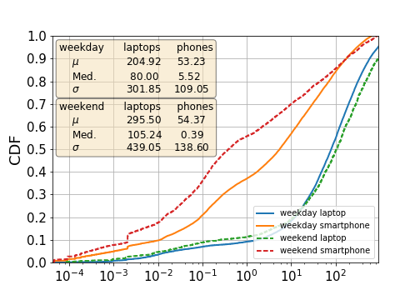
User-centric (temporal) analysis
90% of cellos consume < 700MB, for flutes < 200MB
Median traffic consumption of flutes is near zero on weekends. Whereas remaining cellos consume more.
Flutes
Cellos
Traffic Consumption (MBs per day)

Slide 74
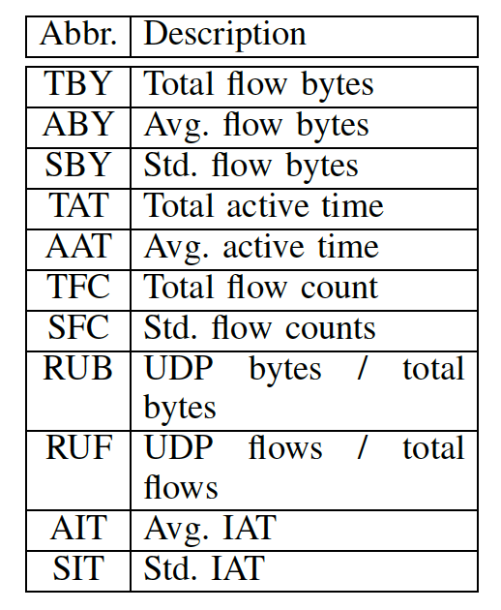
Weekday
Weekend
Network Traffic Features

Slide 75
Modeling Insights
Can we classify devices using their mobility and/or traffic features?
Accuracy:
Mobility alone → 65%
Traffic alone → 79%
Mobility and traffic → 81%
Mobility and traffic, separate features for weekdays/weekends → 86%
Users’ behavior (both flutes and cellos) is more distinguishable with combined mobility and traffic features; especially when temporal features such as weekdays are considered separately from weekends.
( than either mobility or traffic alone)
Notes:
SVM classifier. 5-fold Cross-Validation. Using default parameters.

Slide 76
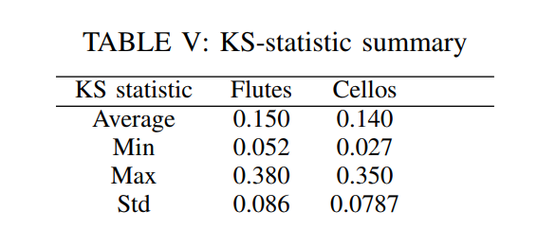
Modeling insights
Gaussian Mixture Model (GMM):
Combined Mobility-Traffic features → Average KS statistic of all features is 0.15 for flutes and 0.14 for cellos.
Importantly, the combined model produces samples whose mobility or traffic features match the original data better, compared with training a GMM on mobility or traffic features alone (based on KS statistic).

Slide 77
Next steps? continued
Flutes and cellos are likely two points in a dimension that is continuously changing:
Differentiation in device classes appear, for example, smartphones vs tablets – do we have “guitars” as well!? (Prof. Jörg Ott suggested the ‘guitar’ category.)
New devices such as fitness trackers, smart watches, glasses, etc.
New form factors for smartphones/tablets could blur the line again.

Slide 78
Conclusion
AP associations allow us to calibrate user mobility and determine their community structures (and “hotspots”), while daily and weekly activity patterns help outline user schedules—which could be parameterized.
Traffic flows per device can be created from our corresponding distributions, while AP traffic observations allow parameterizing the above “hotspots” with respect to user activity.
This could form a basis for generating parameters for established mobility models, possibly extend them as needed, and augment them with adequate correlated traffic models.

Slide 79
Conclusion
It is crucial to differentiate flutes vs. cellos for both mobility and traffic due to their very different nature. Correlations of these features matter, and should be captured in models!
Traffic generation, spatial locations, and temporal behavior can be linked per device type and per user “community” (e.g., students of different disciplines at various buildings).
There is significant potential for integrated mobility-traffic models that capture relationships across device types, time and space.

